Slide 1


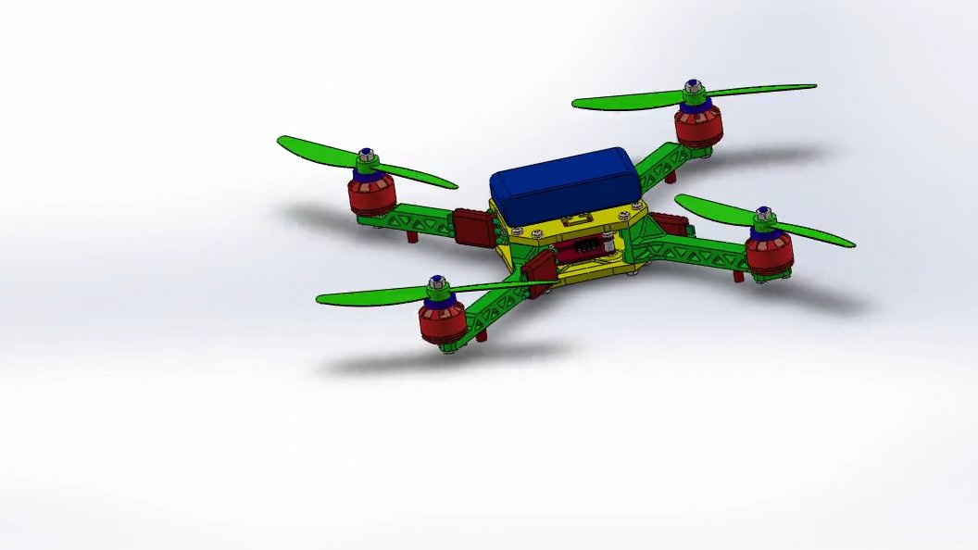

MicroQuad-X250: Modular UAV Platform for Engineering Applications
SolidWorks Design Project for Educational Applications
DESIGN OVERVIEW
What is MicroQuad-X250?
- A 250mm quadcopter design concept created in SolidWorks
- Features color-coded modular components for easy identification
- Designed around the principle of component accessibility
- Targets educational markets where students need hands-on learning
- Emphasizes design-for-assembly methodology
Why This Matters
- Modular architecture allows individual component replacement
- Color-coding system simplifies component identification
- Standardized fasteners reduce tool requirements
- Symmetric X-frame configuration for balanced performance
- Educational focus prioritizes learning over peak performance

Slide 2
Design Challenge: Making Complex Technology Accessible
How Modular Design Addresses Educational Needs
The Problem with Current Educational Drones
Sealed enclosures prevent students from accessing components.
When one part fails, entire units need replacement.
Complex assembly procedures discourage hands-on learning.
Students can't see how individual systems work together.
Repairs require specialized knowledge and tools.
Our Design Approach
Modular architecture: Every major system can be separated.
Color-coded organization: Visual system for component identification.
Standardized connections: Common fasteners throughout the design.
Accessible layout: Components positioned for easy access.
Symmetric design: Reduces complexity and part count.
Design Methodology
Started with component identification and color-coding system | Designed frame structure to accommodate modular electronics.
Created standardized mounting interfaces for all systems | Developed an assembly sequence that builds the grasp progressively.
The Goal
Create a drone design that teaches engineering principles through its construction process, not just its operation.

Slide 3
Why Current Educational Drones Don't Work Well
The Challenge of Learning with Complex Technology
THE PROBLEM WITH CURRENT DRONES
What's Wrong Today
- When a drone crashes, the whole thing might be ruined
- Students can't see or touch the important parts inside
- Repairs are expensive and take weeks
- Assembly instructions are too complicated for beginners
- One broken part means buying a whole new drone
Our Solution: Think Like Building Blocks
- Every major part can be removed and replaced separately
- All parts are color-coded so you know what goes where
- Only need one simple tool (like a screwdriver) for everything
- If the motor breaks, just replace the motor - not the whole drone
- Students learn by actually handling each component

Slide 4
Performance and Capabilities Overview
What You Can Expect from This Drone
The Five Main Systems:
- GREEN Parts: The frame and body structure
- RED Parts: The motors and propellers (makes it fly)
- BLUE Parts: The "brain" and sensors (keeps it stable)
- YELLOW Parts: The battery and power system
- GRAY Parts: All the screws and connectors
Flight Performance
- Flies for 10-15 minutes on one battery charge
- Can carry small cameras or sensors (about 80 - 140 g)
- Flies up to 30 mph in sport mode
- Stable in winds up to 15 mph
- Can hover precisely in one spot
- Range: About 300 feet from the controller
Real-World Applications
- Photography and videography training
- Search and rescue simulation
- Agricultural monitoring practice
- Basic autonomous flight programming
What Makes It Special:
- Each colored system can be removed separately
- All parts connect with standard screws
- No special tools needed - just one hex key
- Built-in safety features prevent dangerous flying
- Designed to survive crashes and keep working

Slide 5
Five-System Modular Architecture
Color-Coded Design for Component Organization
GREEN System - Frame Structure: - X-frame configuration with lattice-pattern arms - Integrated landing gear design - Motor mount plates with vibration consideration - Central battery compartment with secure retention - Quick-release arm attachment points
RED System - Propulsion: - Four 2204 brushless motor mounts - Integrated propeller mounting system - Motor wire management channels - Thrust-optimized motor positioning - Counter-rotating propeller configuration
BLUE System - Flight Control: - Protected flight controller housing - IMU sensor integration design - Vibration isolation mounting - Accessible programming interface - Antenna placement optimization
YELLOW System - Power Management: - Dual-compartment electronics housing - ESC integration with thermal considerations - Power distribution board mounting - Battery management system interface - Overcurrent protection design
GRAY System - Hardware: - M3 stainless steel fastener specification - Standardized hex key requirement (2.5mm) - Consistent torque specifications throughout - Minimal fastener count for simplicity - Strategic fastener placement for accessibility
Design Integration: All systems connect through standardized interfaces, enabling independent component access while maintaining structural integrity and electrical connectivity.

Slide 6
Frame Design and Material Considerations
Balancing Strength, Weight, and Educational Access
Frame Geometry Design: - X-configuration provides optimal motor placement - Diamond-pattern lattice arms balance strength and weight - Integrated landing gear eliminates separate components - Symmetric design reduces manufacturing complexity - Recessed battery compartment lowers center of gravity
Material Selection Considerations: - Polymer composite frame for educational durability - Aluminum electronics housing for electromagnetic shielding - Stainless steel fasteners for corrosion resistance - Design accommodates various material options - Weight optimization through strategic material placement
Structural Features: - Vibration isolation between motors and electronics - Stress distribution through lattice arm design - Impact protection for critical components - Modular arm design enables easy replacement - Integrated cable management throughout structure
Design Specifications: - Frame diagonal: 250mm (motor centerline to centerline) - Overall height: 85-95mm including landing gear - Arm length: 125mm from center to motor mount - Component count: 14 primary assemblies - Total design weight target: 335-445g
CAD Design Benefits: - Parametric design allows easy dimension modifications - Assembly constraints ensure proper component fit - Design visualization helps identify potential issues - Material properties can be easily modified - Assembly sequence can be optimized through CAD analysis

Slide 7
Design for Assembly Methodology
44444
CREATING INTUITIVE BUILD PROGRESSION
Step 1: Frame Assembly (Green Components)
- Central frame pieces connect with visible fasteners
- Arm attachment points clearly marked
- Landing gear integrated into frame structure
- Battery compartment becomes immediately apparent
- Foundation for all other systems established
Step 2: Propulsion Integration (Red Components)
- Motor mounts attach to arm terminations
- Propeller attachment points clearly visible
- Motor wire routing becomes apparent
- Thrust vector alignment designed into geometry
- Counter-rotation requirements become clear
Step 3: Electronics Housing (Blue/Yellow Components)
- Dual-compartment design separates systems
- Flight controller protection clearly demonstrated
- Power management system organization visible
- Wiring harness routing designed for clarity
- Component accessibility maintained throughout
Step 4: Hardware Integration (Gray Components)
- Standardized fastener approach becomes apparent
- Single tool requirement demonstrated
- Torque specifications consistent throughout
- Assembly mistakes minimized through design
- Maintenance access points clearly identified
Step 5: Final Integration and Balance Check
- Component weight distribution becomes apparent
- Center of gravity optimization visible
- System integration demonstrated
- Troubleshooting access points clear
- Overall system operation becomes understandable
Design Benefits
- Each step builds on previous knowledge
- Assembly sequence reinforces engineering principles
- Mistakes are minimized through design constraints
- Students understand function through construction
- Modular approach enables easy modifications

Slide 8
Performance Parameters and Design Targets
44444
ENGINEERING CALCULATIONS BEHIND THE DESIGN
Physical Design Parameters:
- Frame diagonal: 250mm (optimized for stability vs. portability)
- Overall height: 85-95mm (includes integrated landing gear)
- Component weight distribution designed for balance
- Center of gravity positioned for stable flight characteristics
- Modular design adds minimal weight penalty
Power System Design:
- Four motor configuration for redundancy and control
- Power consumption estimated at 200-280W continuous
- Battery integration designed for 1500mAh 3S LiPo
- Power distribution optimized for efficiency
- Thermal management considerations built into housing design
Performance Design Targets:
- Thrust-to-weight ratio: 2.5:1 minimum design target
- Flight duration: 10-15 minutes with standard battery
- Payload capacity: 100-150g for educational sensors
- Operating envelope: Designed for indoor/outdoor use
- Control range: 300 feet for educational applications
Weight Distribution Analysis:
- Frame structure: 65-85g (optimized polymer composite)
- Propulsion system: 120-160g (four brushless motors)
- Electronics package: 135-175g (dual-compartment design)
- Hardware: 15-25g (stainless steel fasteners)
- Total design weight: 335-445g (battery dependent)
Design Validation Approach:
- SolidWorks mass properties analysis
- Center of gravity calculations
- Component interference checking
- Assembly constraint validation
- Design rule checking for manufacturability
Educational Design Considerations:
- Assembly time target: 25-35 minutes
- Tool requirement: Single 2.5mm hex key for 85% of operations
- Fastener count: 20-25 pieces total
- Component count: 14 primary assemblies
- Disassembly/reassembly cycles: Designed for repeated use

Slide 9
Design Summary and Recommendations
44444
MICROQUAD-X250 DESIGN PROJECT CONCLUSIONS
DESIGN OBJECTIVES ACHIEVED
Primary Design Goals:
✓ Modular architecture successfully implemented
✓ Color-coded component organization system developed
✓ Standardized assembly methodology established
✓ Educational accessibility prioritized throughout design
✓ 250mm form factor maintained within specifications
Key Design Features:
- Five-system modular architecture
- Single-tool assembly requirement (2.5mm hex key)
- 14 primary assemblies with standardized interfaces
- Target weight: 335-445g including battery
- Symmetric X-frame configuration for balanced performance
RECOMMENDATIONS
Design Validation:
- Prototype development recommended to validate design concepts
- Component interface verification required
- Assembly sequence optimization through physical testing
- Material selection confirmation for educational environments
PROJECT DELIVERABLES
Complete CAD documentation including:
- Full assembly model with all components
- Individual part drawings and specifications
- Exploded assembly views for documentation
- Bill of materials with component specifications
- Assembly sequence documentation
Future Enhancement Opportunities
- Advanced sensor integration capabilities- Payload interface standardization
- Manufacturing cost optimization- Alternative material configurations
CONCLUSION
The MicroQuad-X250 design successfully demonstrates the application of modular
design principles to educational UAV applications. The SolidWorks design provides
a comprehensive foundation for prototype development and further refinement.

